Slide 1
Rhythm Runner
Team X:
Dillon Hour
Paul Fussell
Hongyou Xiong

Slide 2
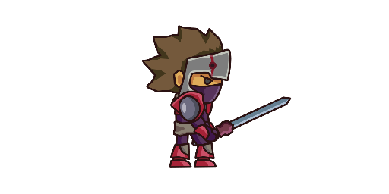
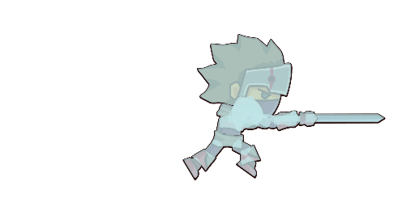


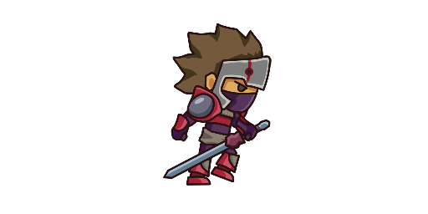
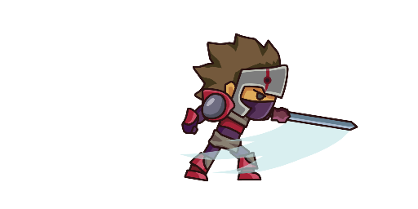
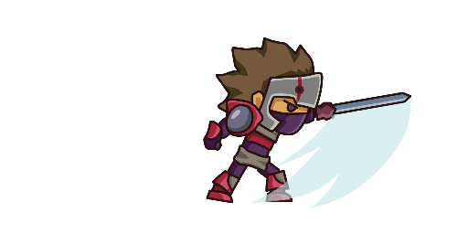
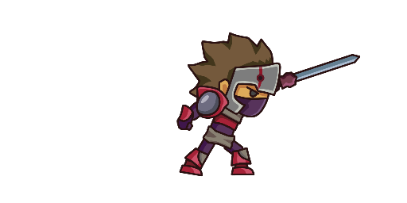
What is Rhythm Runner?
Game with multiple genres:
Runner Type Game
2D Platformer
Music
Sound Frequencies changes w/ player actions
*Sword is PAID DLC
Notes:
Rhythm Runner is a side scroller rhythm running style game. The purpose of this game is combine musical beats, and sound frequencies with the player actions. Each player will have a one to two minute experience on each level with 3 different levels to complete. The player's objective is to run across platforms, collect coins, and dodge the pitfalls and traps along the way. The coins collected will gradually increase the pace of the music as well as the speed of the character, making the game feel more hectic as the player does well.

Slide 3








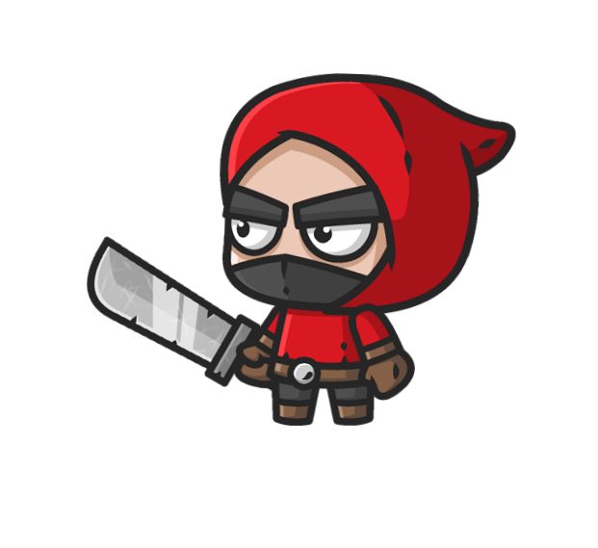


Game Objective
Conquer 3 Unique Levels
Collect Coins
Dodge Enemies/Obstacles.
Beat Your Highscores

Slide 4
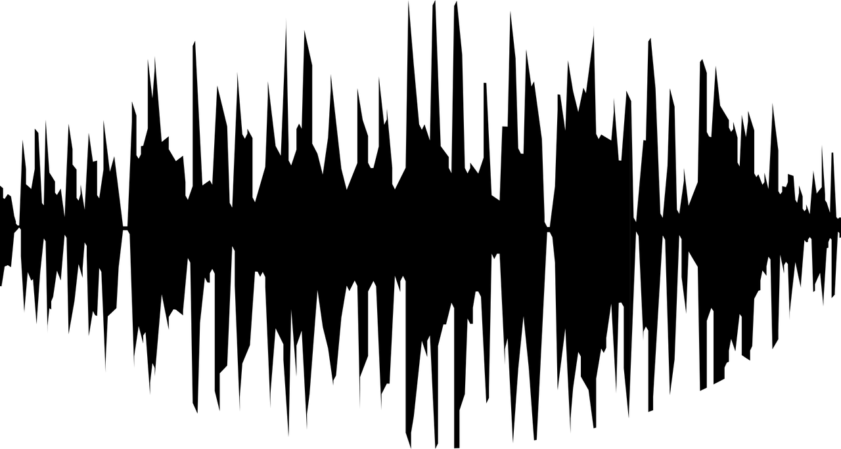
Sound Frequency
Fast Fourier Transformation
On Level 3, Use FFT on next 15 ms of audio, find highest frequency
If highest frequency below D3 (140ish hz), then place coin here
Could not do it while game running, so placed all coins in level instead of generating
Very time consuming, only did for level 3
After Collecting 20 Coins, pitch of music increases (about .04 pitch per 20 coins)

Slide 5


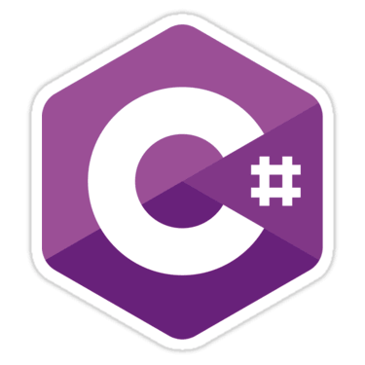


Tools
GitHub
Unity
C#
Photoshop
Visual Studio
Private, public, or open source, all repositories are equipped with tools to help you host, version, and release code.
A game developing platform that is fast and easy to learn.
C# enable rapid application development while retaining the expressiveness and elegance of C-style languages.
A tool that can help create and edit the game sprites and assets.
An IDE to help write and edit C# Scripts

Slide 6





Requirements
Must Have a Computer (Mac, Windows, or Linux)
Must Have Wireless or Internet Connection
Mouse and Keyboard.
Refined Taste

Slide 7

Playtesting
Playtested our own game internally and with couple additional users
Tested various versions of traps, coins, enemies
Tested audio code by using Visual Studio Debugger and stepping through while game was running

Slide 8
GAME DEMO...

Slide 9
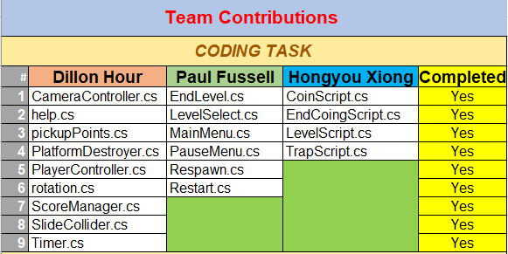

Slide 10
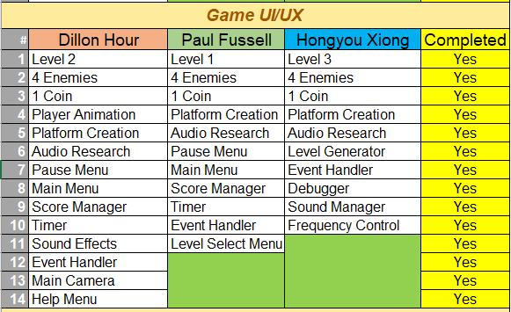

Slide 11
GitHub: https://github.com/DH-PF-HX-COMP47-RhythmRunner/DH-PF-HX-COMP47-RhythmRunner

